Slide 1
AI Grader Using Llama3
By: Noah Shannon

Slide 2
What is an LLM?

Slide 3
Motivation

Slide 4
Methodology

Slide 5
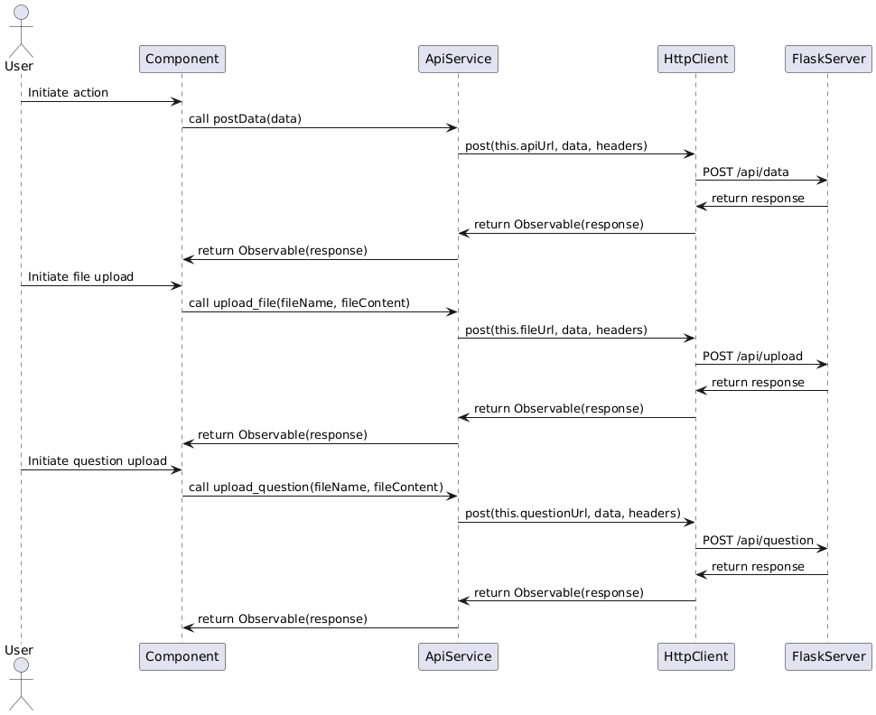
Architecture (Api Service)

Slide 6
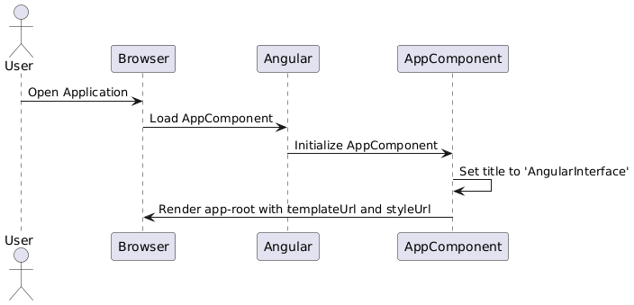
Architecture (App component)

Slide 7
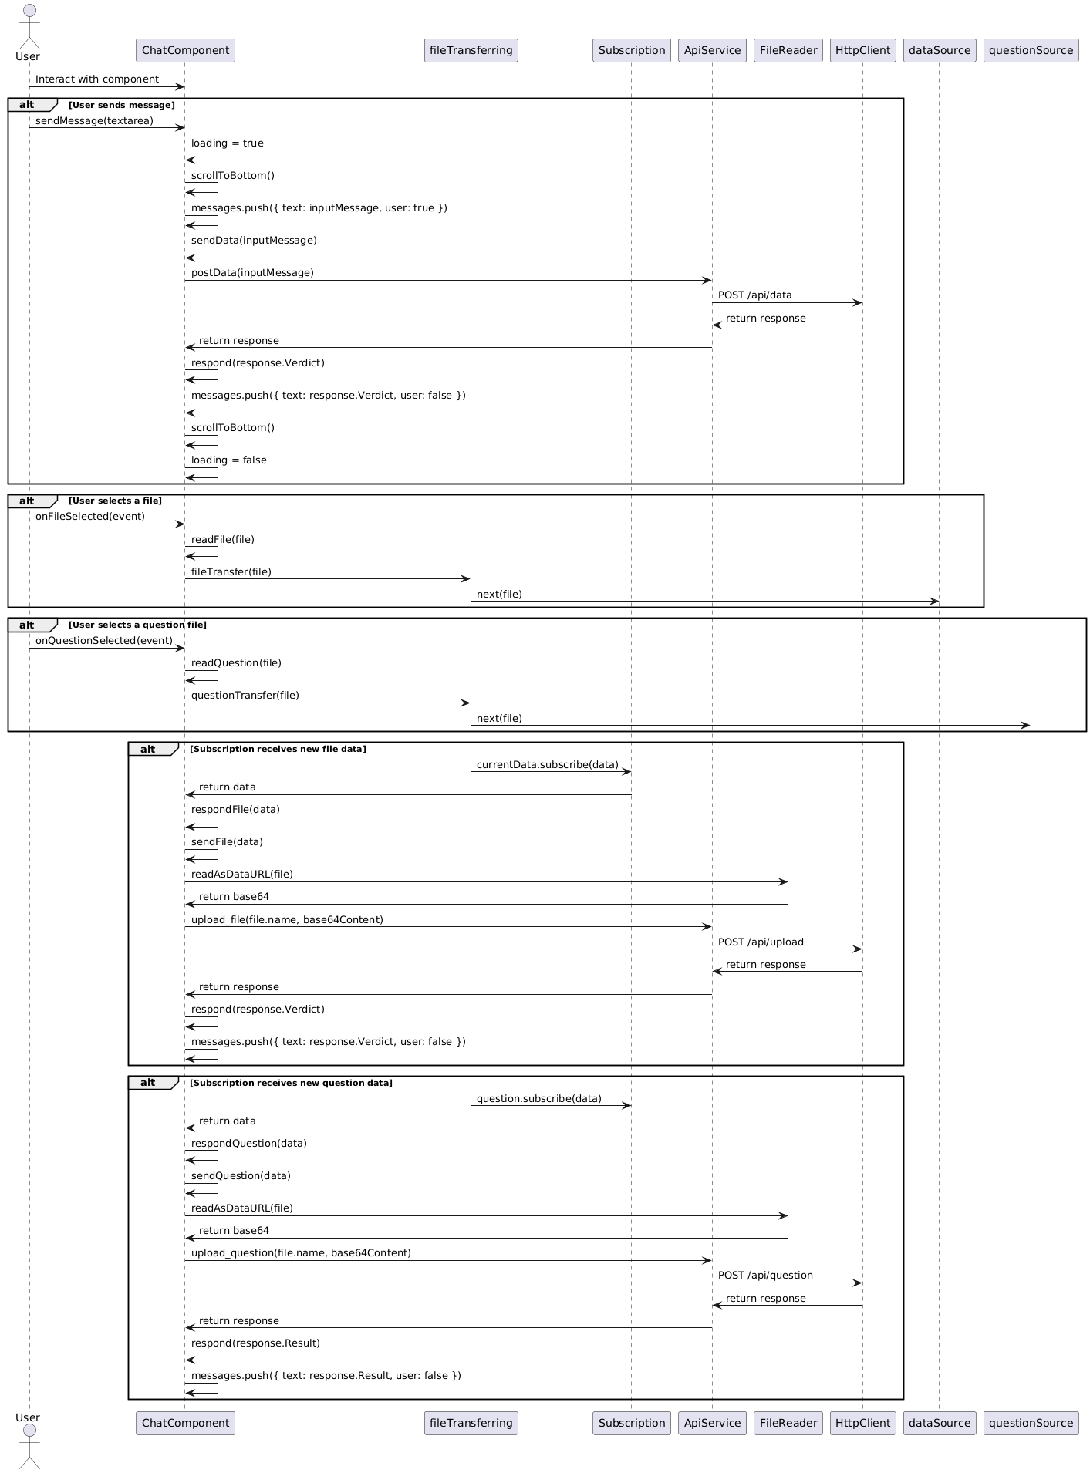
Architecture (Chat component)

Slide 8
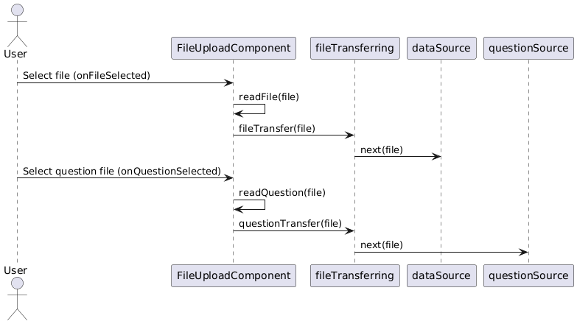
Architecture (File Upload)

Slide 9
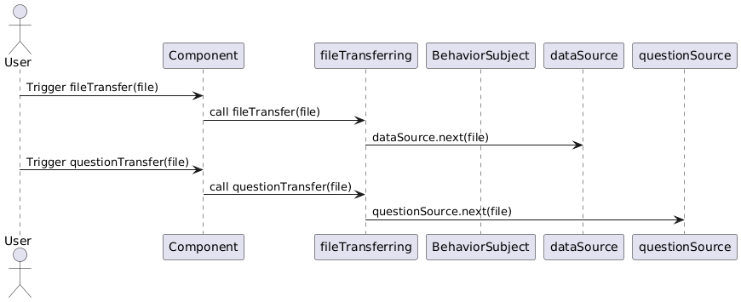
Architecture (File transfer)

Slide 10
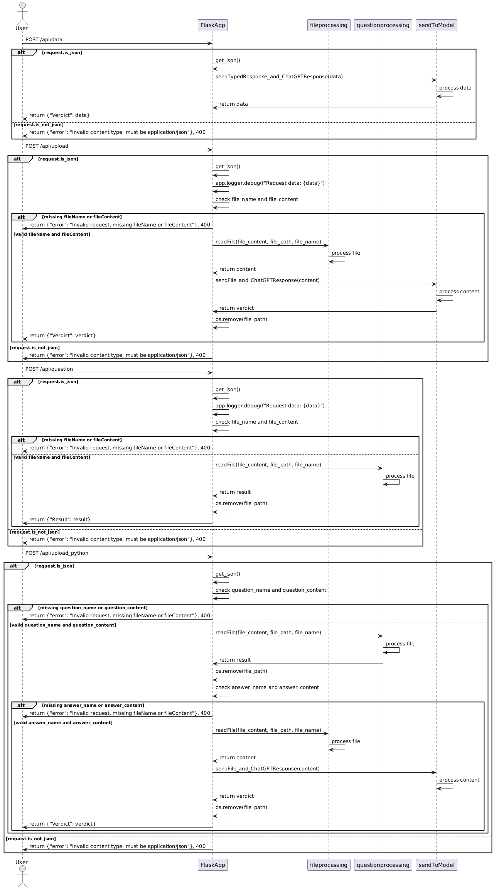
Architecture (Python flask)

Slide 11
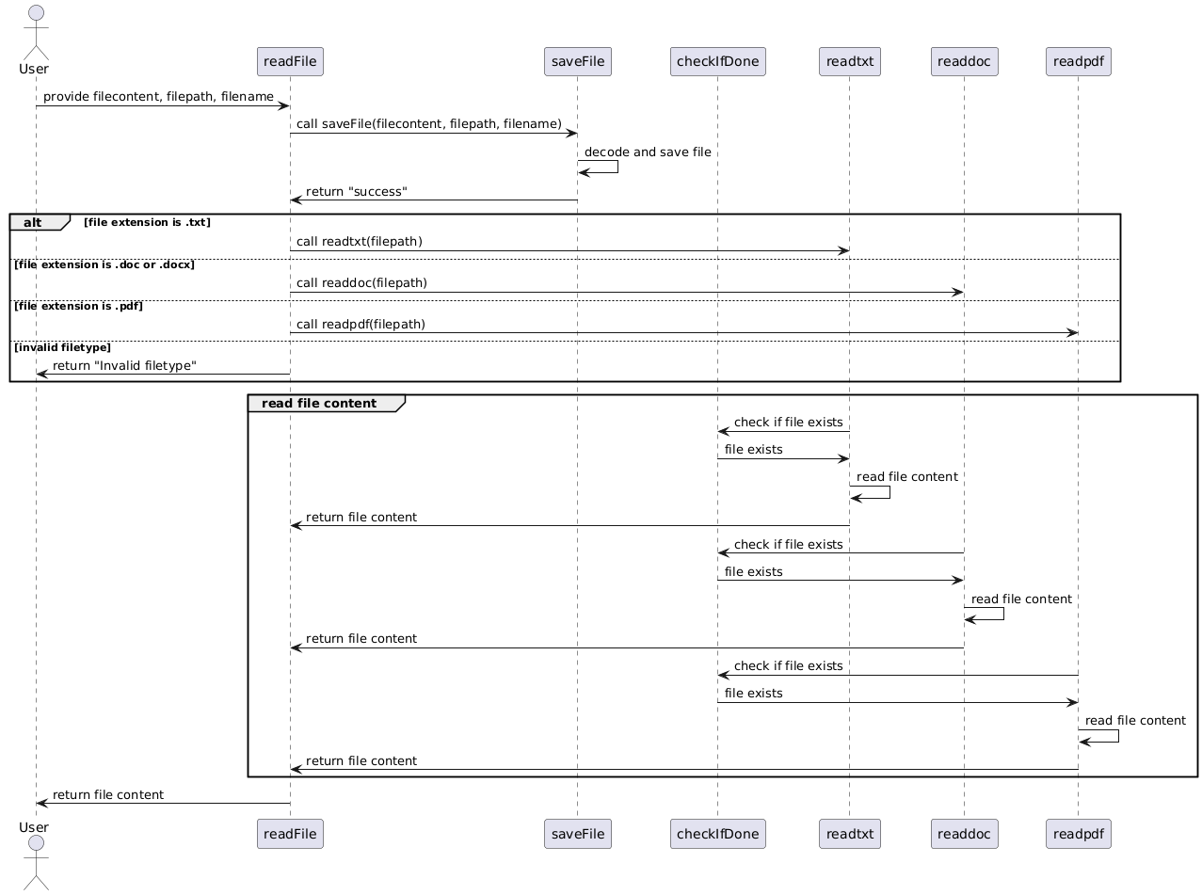
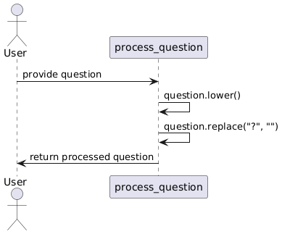
Architecture (question and file processing)

Slide 12
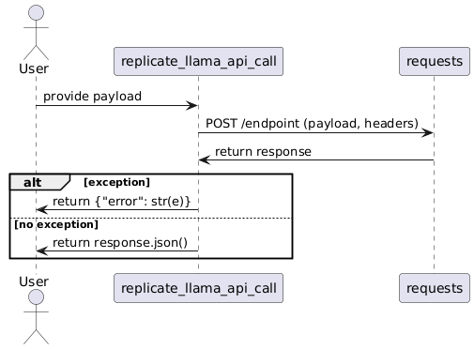
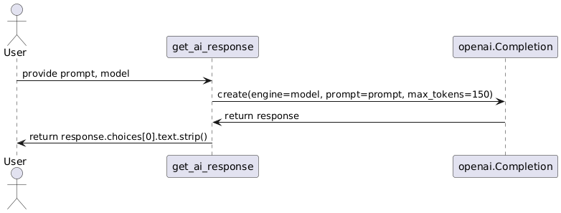
Architecture (API Calls)

Slide 13
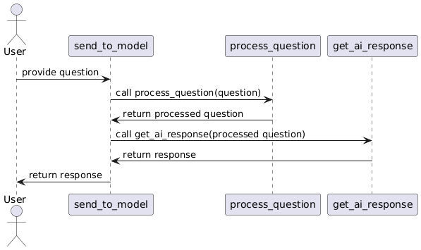
Architecture (Send to model)

Slide 14
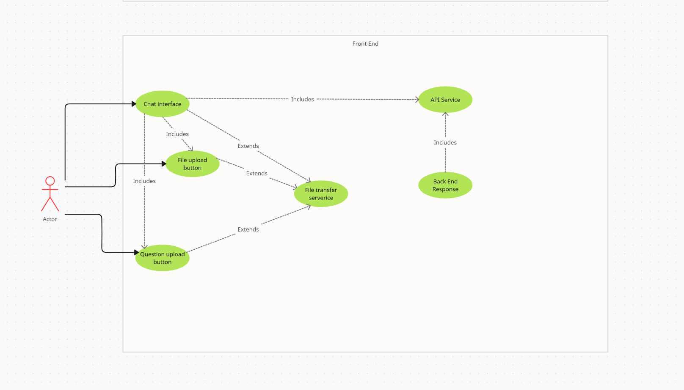
Test Case Front End

Slide 15
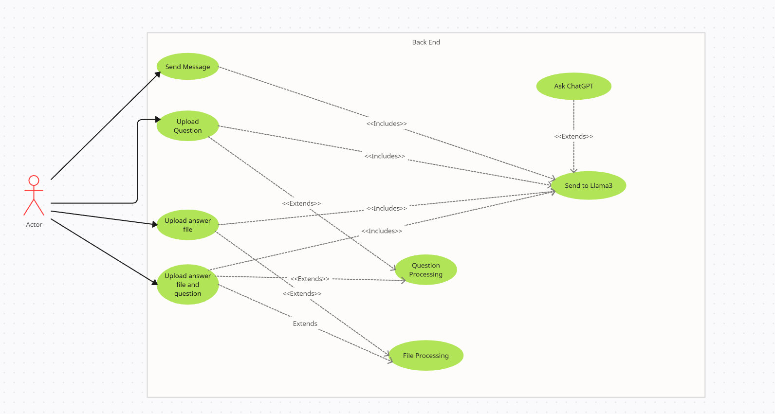
Test Case Back End

Slide 16
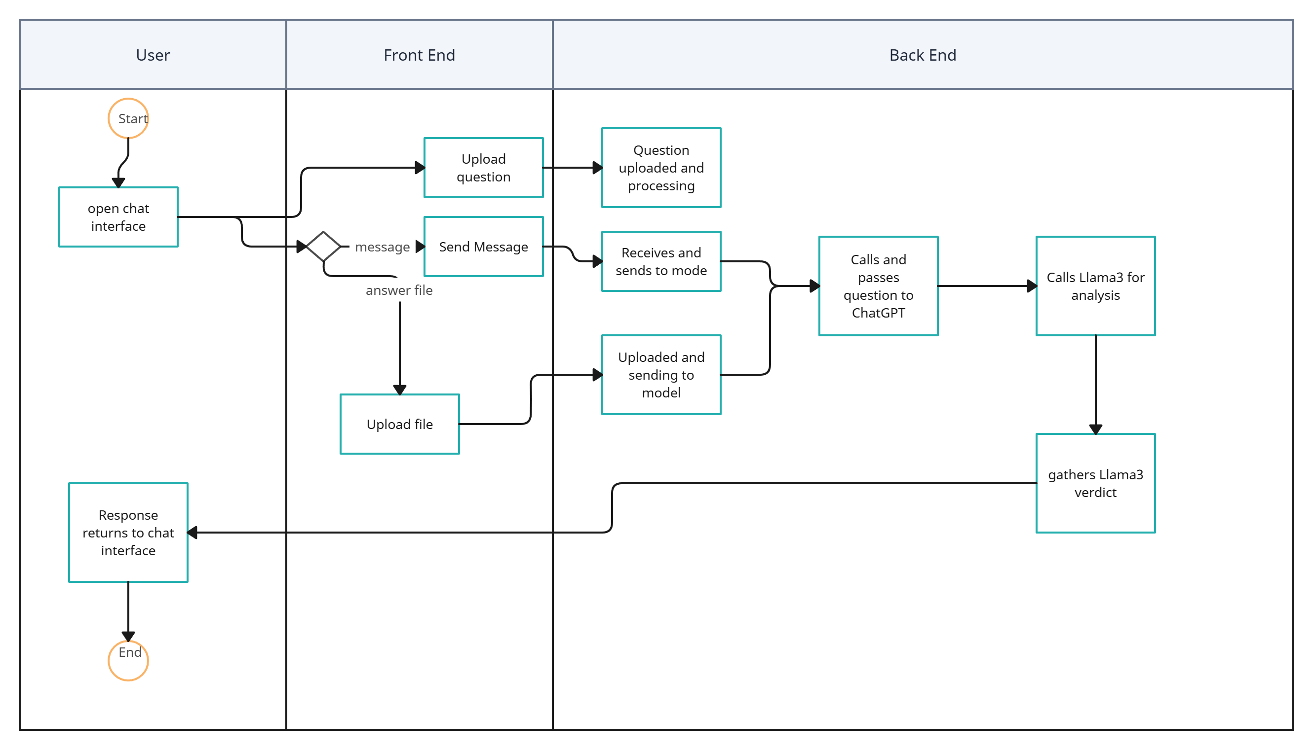
Activity Case

Slide 17
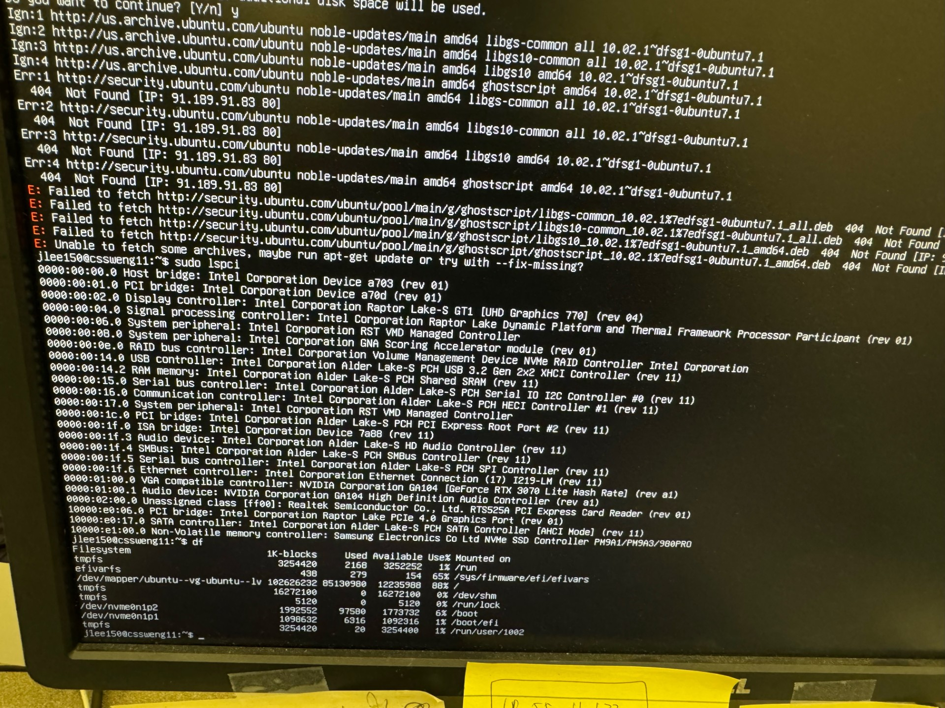
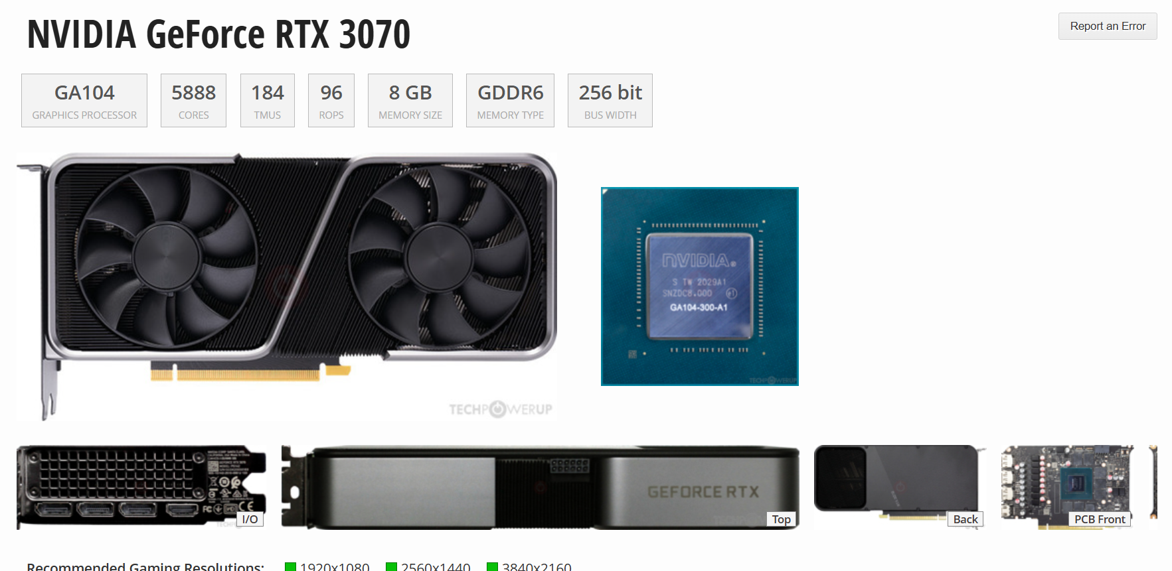
Issues

Slide 18
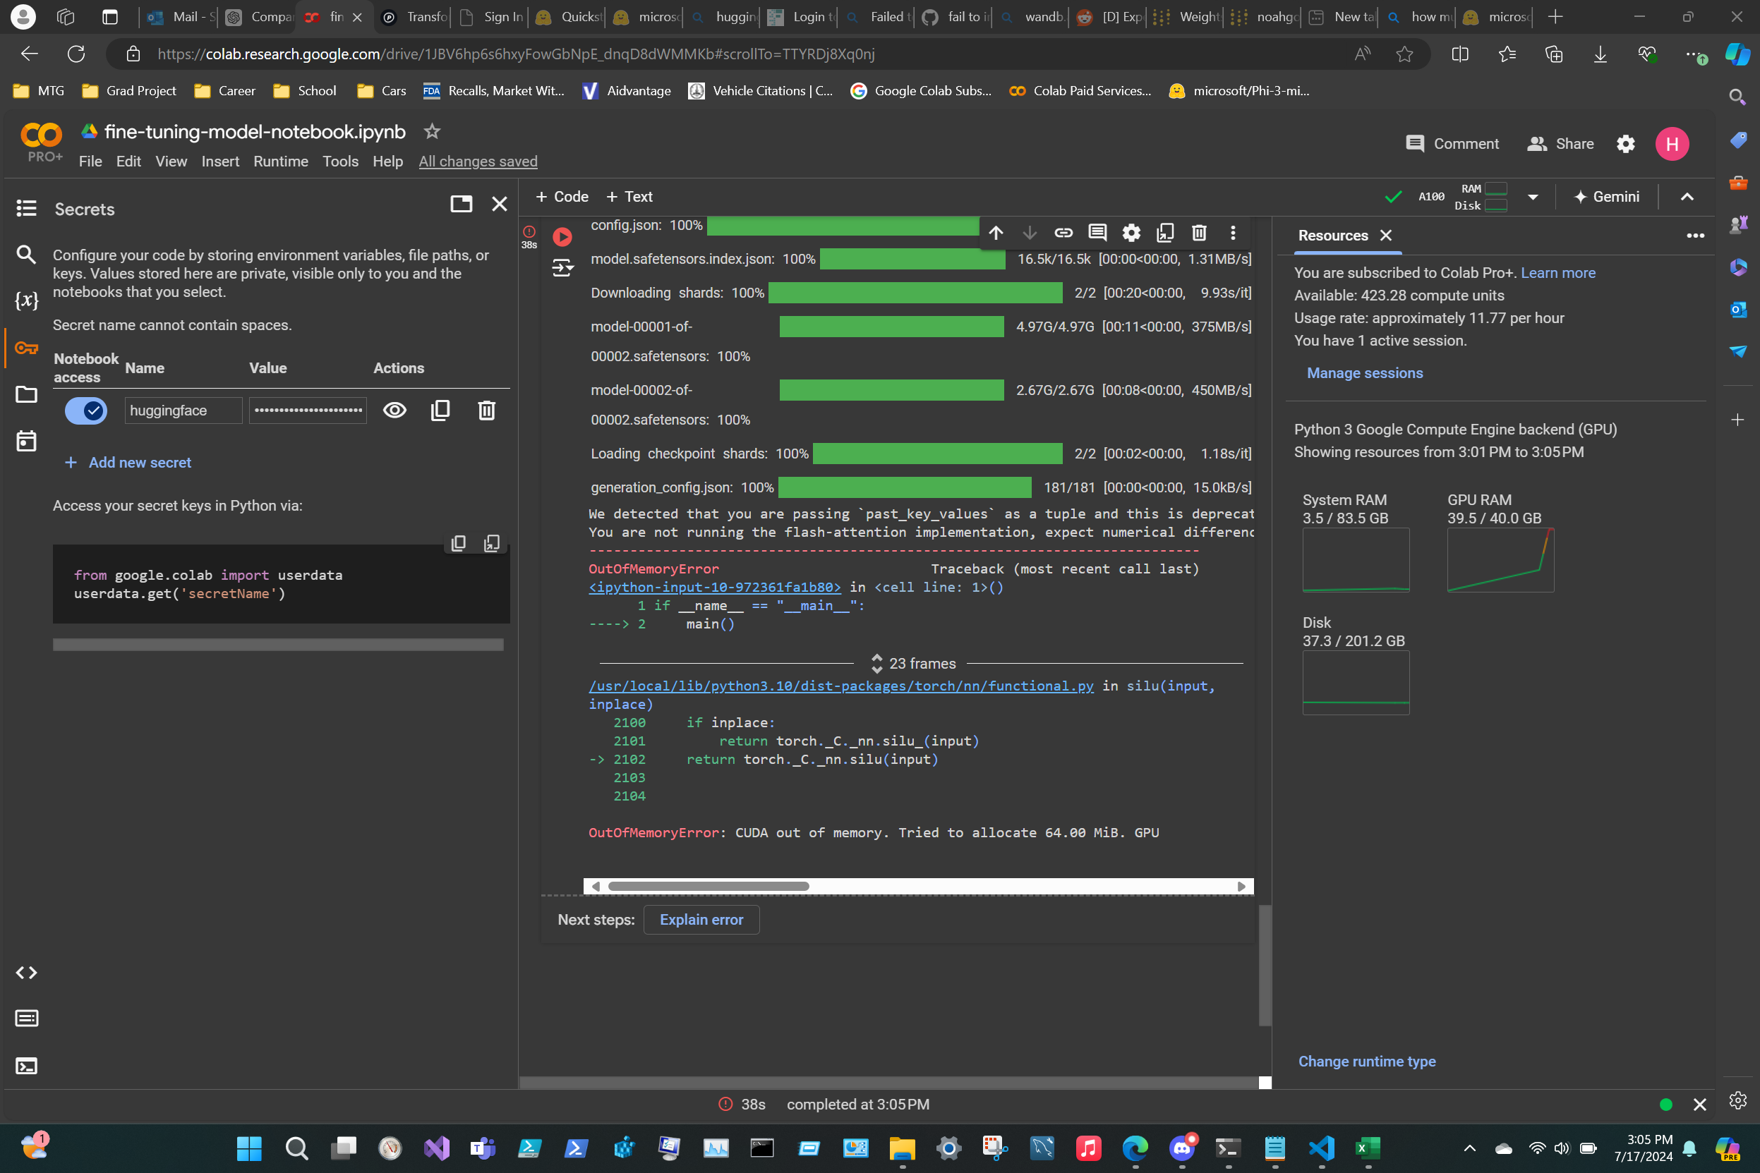
Issues 2

Slide 19
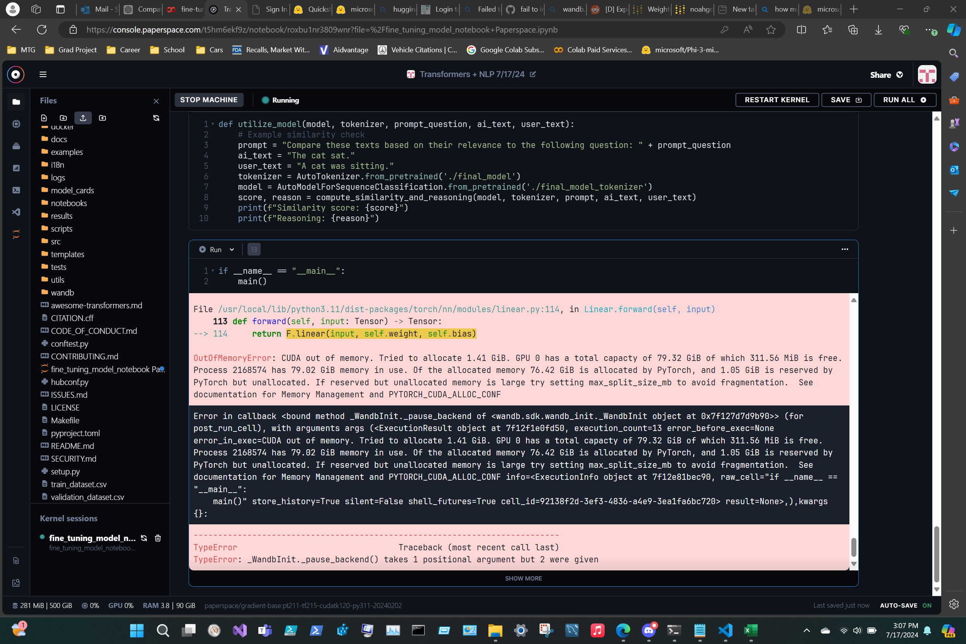
Issues 3

Slide 20
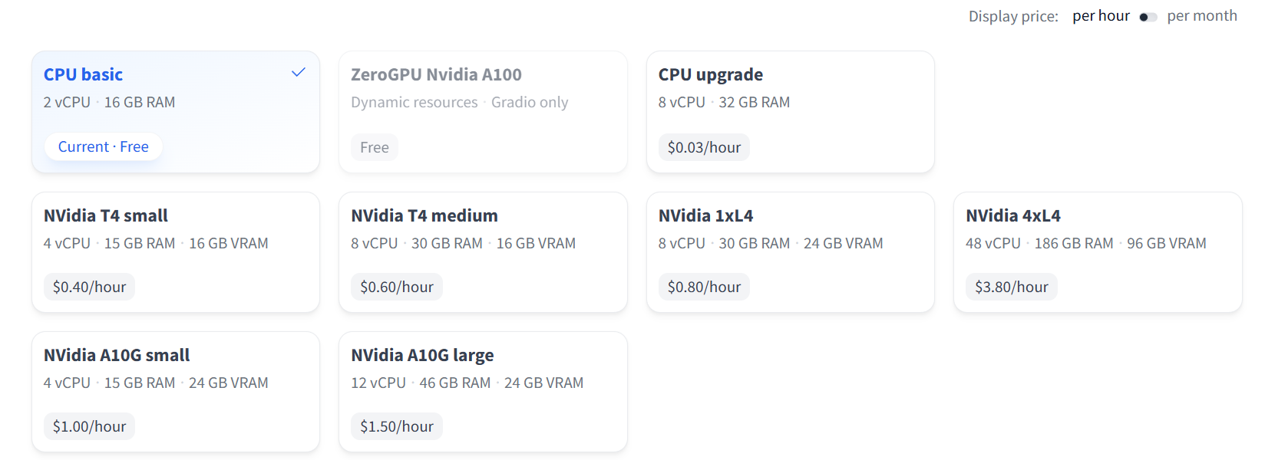
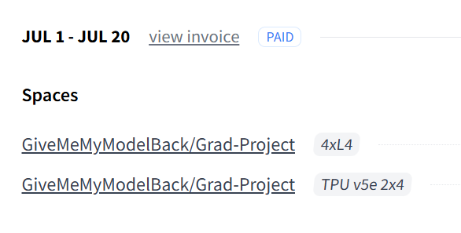
Issues 4

Slide 21
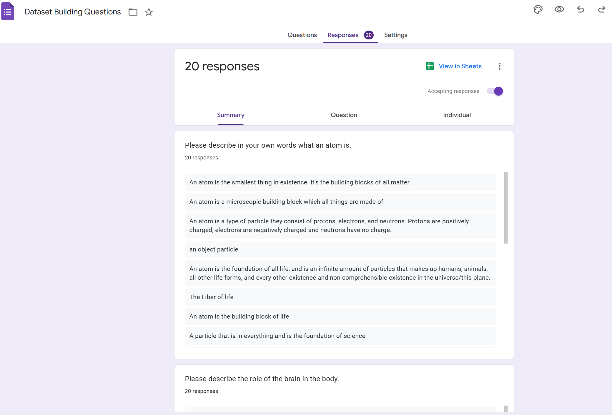
Issues 5

Slide 22
Improvements / Demo!

